Slide 1
What is the MYP?

Slide 2
Research behind the MYP
Research shows that students participating in the MYP:
build confidence in managing their own learning
learn by doing, connecting the classroom to the larger world
outperform non-IB students in critical academic skills
consistently have greater success in IB Diploma Programme examinations
thrive in positive school cultures where they are engaged and motivated to excel
develop an understanding of global challenges and a commitment to act as responsible citizens.
Source: What is the MYP?

Slide 3
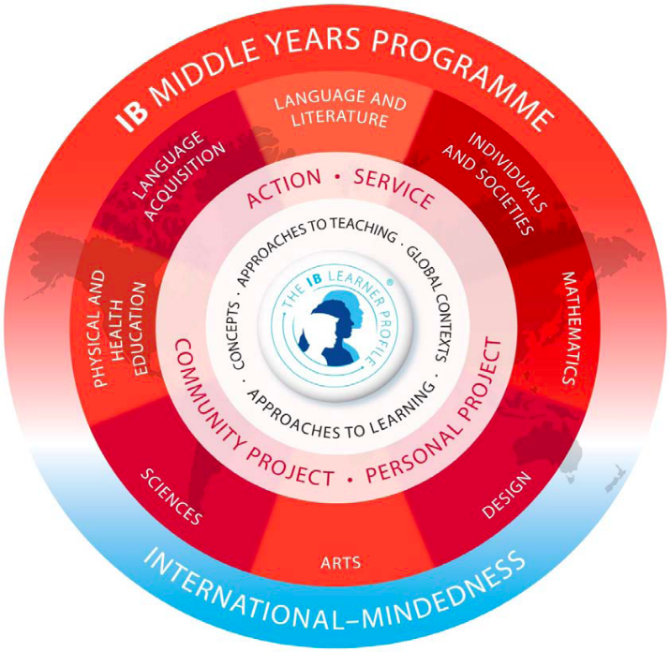
MYP as a holistic learning experience
The MYP is a holistic model: there are no ‘core’ subjects, and the programme is underpinned by a commitment to International-Mindedness
Underpinned by:
ATLs
Key & related concepts
Global contexts
Notes:
Approaches to learning (ATL), helping students learn how to learn by developing skills for research, critical and creative thinking, communication, collaboration, and self-management
Key and related concepts, helping students explore big ideas that matter
Global contexts, helping students understand the relevance and importance of their study for understanding their common humanity and shared guardianship of the planet.
We are now going to take a closer look at each of these three elements within the MYP.

Slide 4
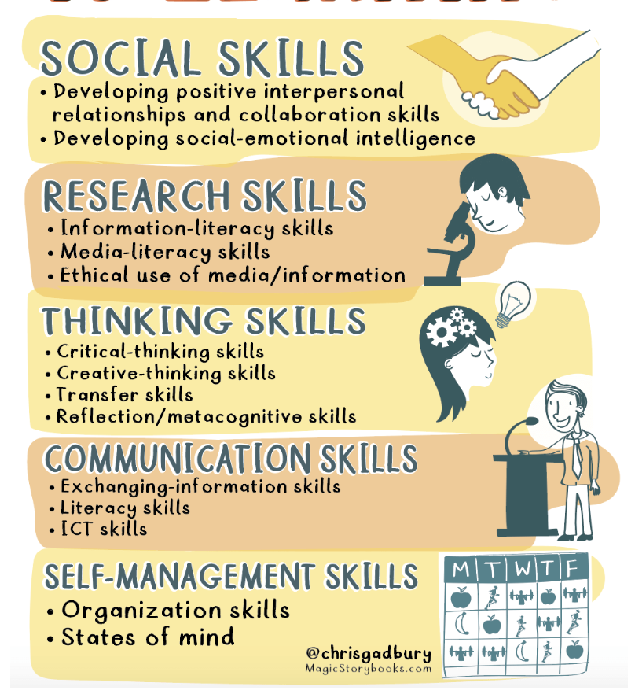
The importance of Approaches to Learning (ATLs)
Represent general and subject-specific learning skills that the students will develop and apply during the programme.
Designed to encourage independent learning.
Make for greater success in transition to the Diploma Programme.
ATL Skills: A teacher's guide

Slide 5
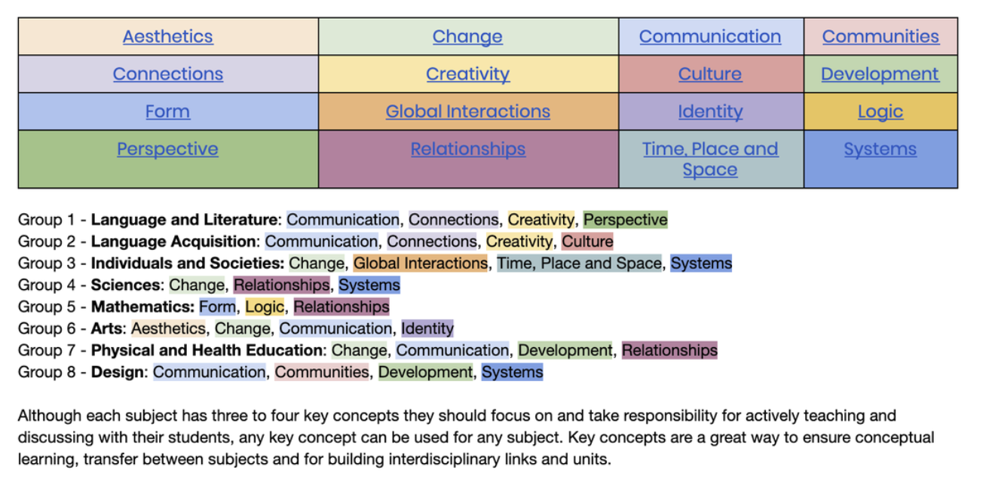
The importance of Key and Related Concepts
Related Concepts, grounded in specific disciplines, explore key concepts in greater detail, providing depth to the programme. They emerge from reflection on the nature of specific subjects and disciplines, providing a focus for inquiry into subject-specific content.
You can find a list of related concepts per subject area here: MYP Central: Key & Related Concepts
Source: MYP Key Concepts
Notes:
Key concepts: provide interdisciplinary breadth to the
programme. Key concepts are broad, powerful ideas that have relevance within and across
subjects and disciplines, providing connections that can transfer across time and culture.

Slide 6
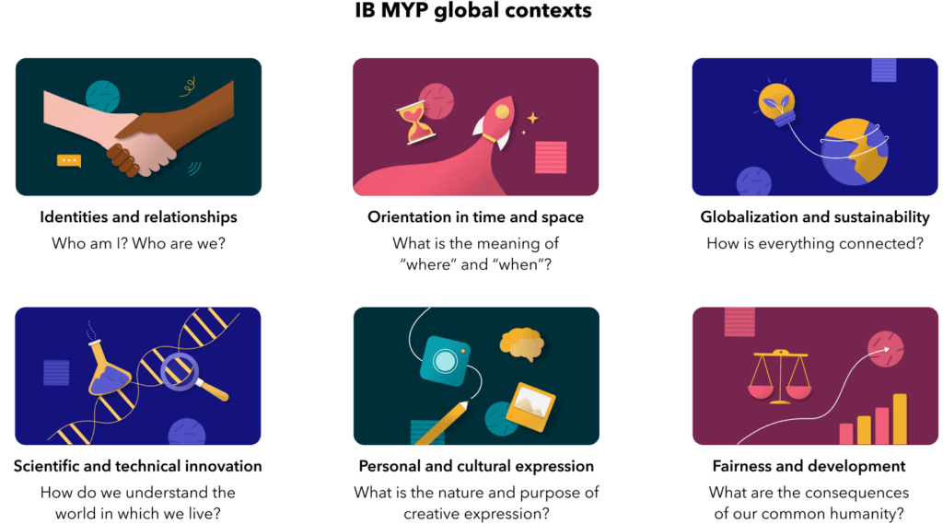
The importance of Global Contexts
Global contexts—showing how learning best takes place in context.
Why learn anything?
Notes:
https://learn.toddleapp.com/docs/your-guide-to-getting-started-with-the-myp/part-2-how-are-myp-unit-plans-designed/global-contexts/
learning in global contexts supports the IB’s mission “to develop inquiring, knowledgeable and caring
young people who help to create a better and more peaceful world through intercultural understanding
and respect”. Using global contexts in planning and teaching helps learners by providing relevance and
meaning, which may lead to increased student engagement

Slide 7
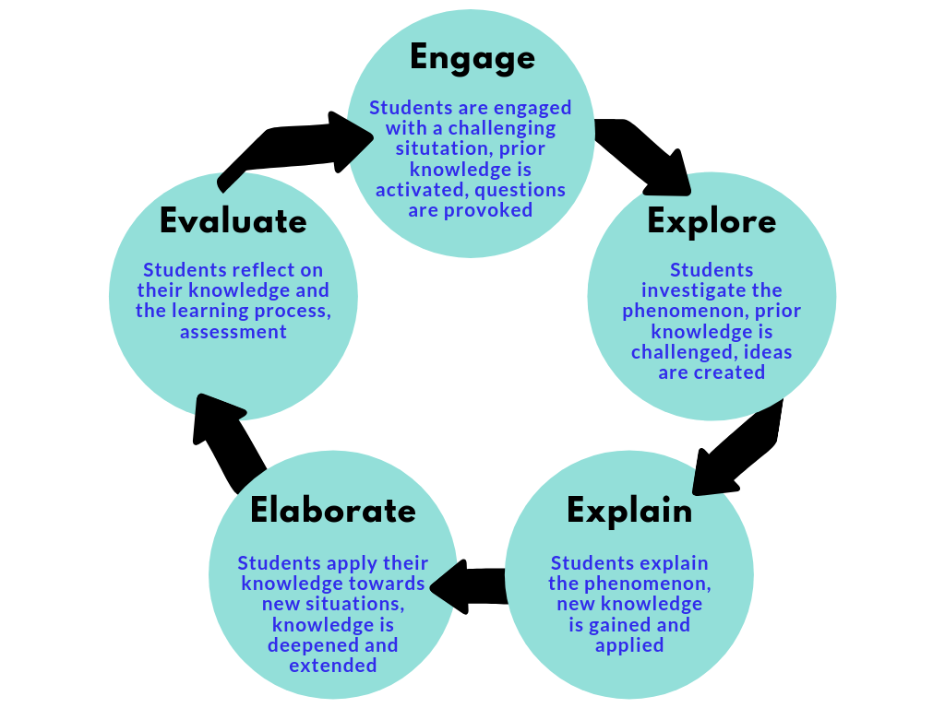
Inquiry based learning
Meanings and practices of inquiry-based teaching and learning in the International Baccalaureate
Goals
• Engaged students, critical thinkers and problem-solvers, and lifelong learners.
• Students develop the dispositions and skills to pursue meaningful questions that are not only interesting to them and others, but that also lead to a better, more
peaceful world.
Source: The 5 E’s of Inquiry-Based Learning
Notes:
Inquiry-based learning forms the foundation of teaching and learning in the MYP. Students are more engaged with this form of instruction, and it helps them to become critical thinkers, problem-solvers, and lifelong learners. Students develop the dispositions and skills to pursue meaningful questions about the world around them.

Slide 8
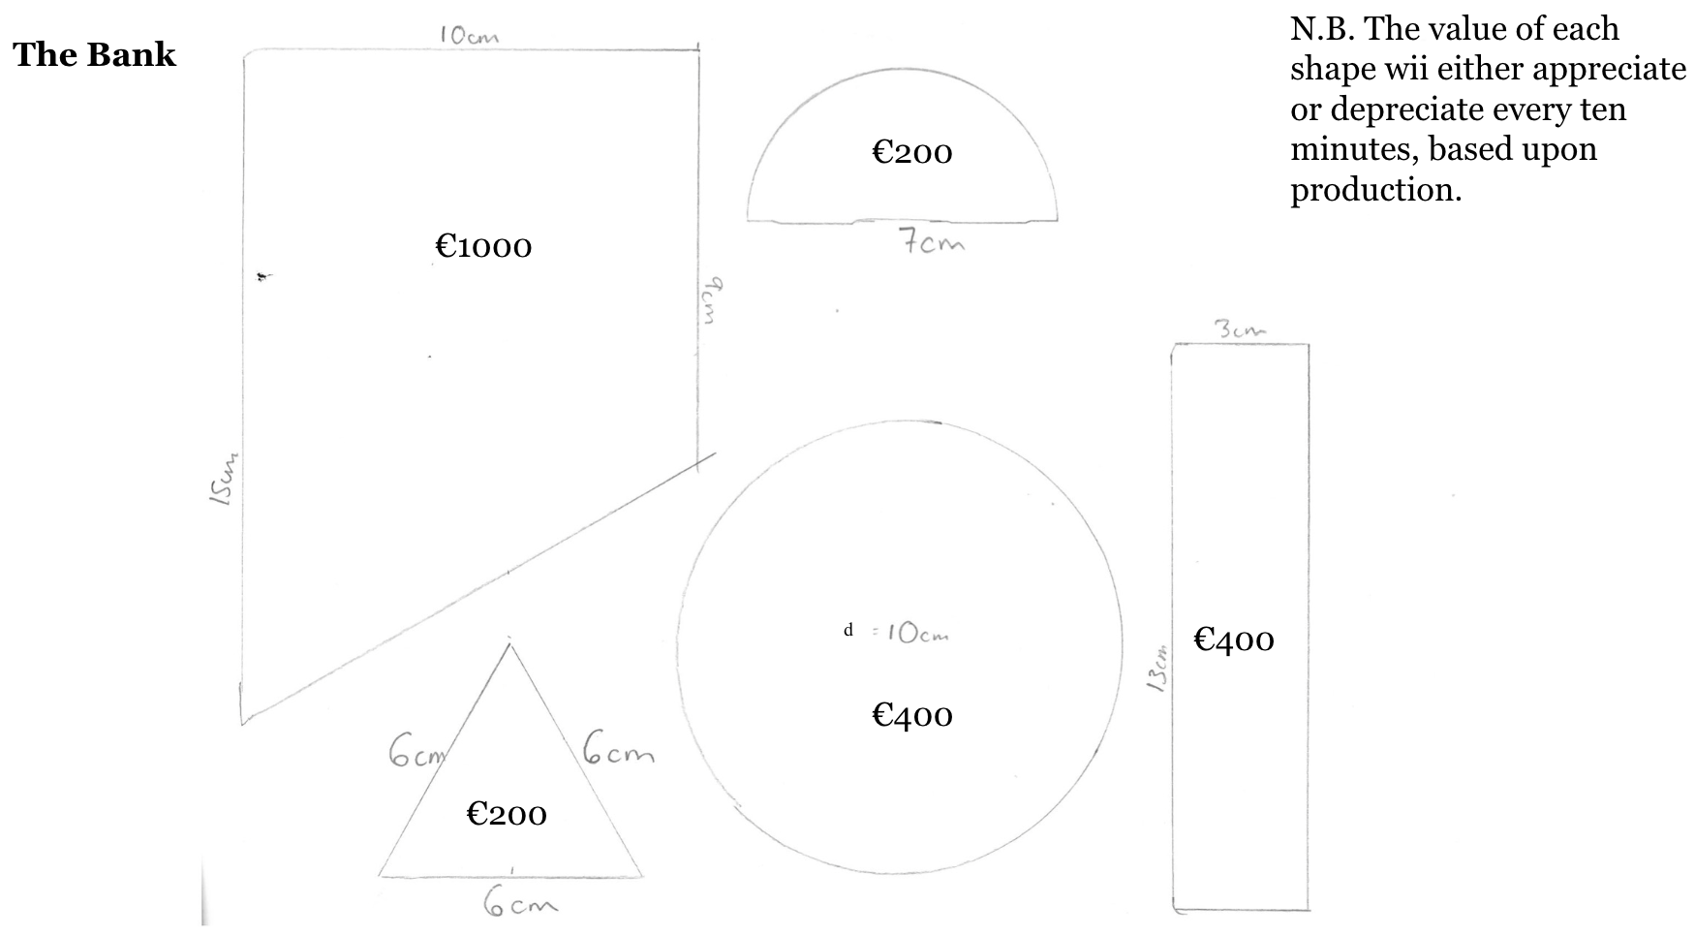
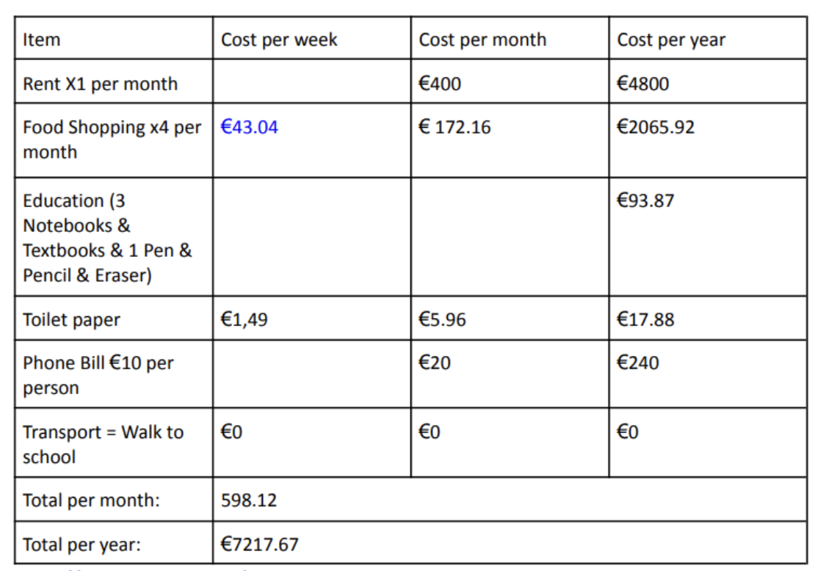
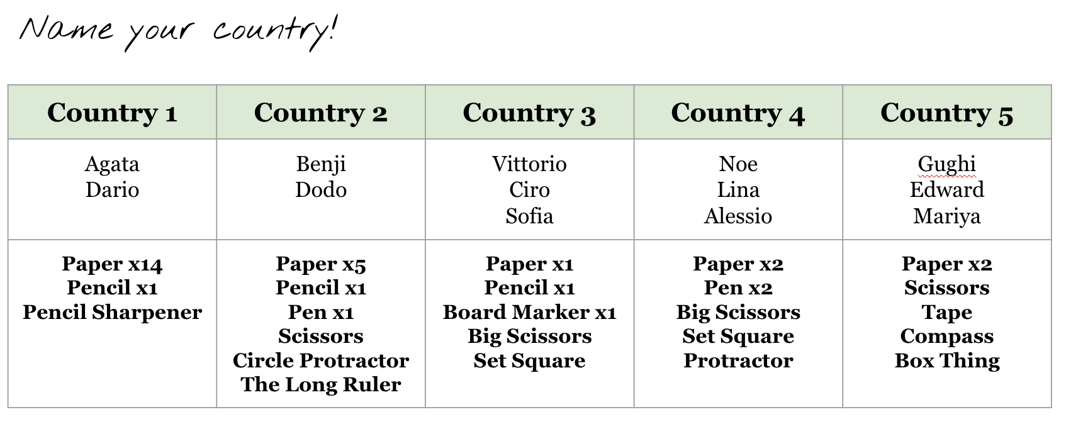
Inquiry based learning at ISG
Exploring international relations & trading through an exchanging simulation in Individuals & Societies Grade 10
Using inquiry into the budgets of refugees in Genova to explore percentage change, in Grade 6 Mathematics.
Notes:
Here are some examples of Inquiry based learning from a 10th grade Individuals and Societies class and a 6th grade Math class. Ultimately, students enjoy learning this way. It helps them to understand the motivations behind learning, and it builds life-long learners.

Slide 9
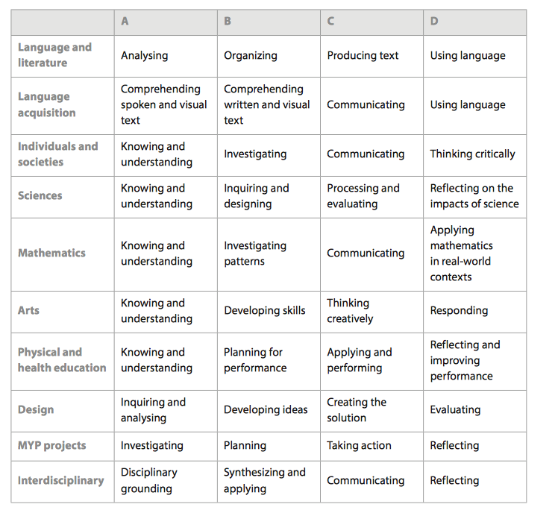
Criteria-based assessment
Students are not ranked against others in their class or year group.
MYP assessment emphasizes individual achievement against set criteria in each subject area.
Students use the descriptors to guide their learning and to motivate themselves to a higher level of achievement.
Notes:
Assessment should be an integral and continuous part of the learning process…Criterion-based assessment is like giving the students a map to get to A to B, as opposed to simply hoping that they will find their way. Being able to read the map is a skill that will help to ensure success every time. It’s important for students and parents to understand the criteria on which students are being assessed for each of their classes.

Slide 10
Formative & Summative Assessments
Students are assessed on one or more Criteria per assessment (for example, a Math assessment which assesses C: ‘Communication’ and D: ‘Applying mathematics in real world contexts’.
Formative (usually one or more during the unit):
Students receive written feedback via Managebac on how to improve (which you can also see & use to talk to your children about their progress!).
Summative (usually one at the end of the unit):
Students receive written feedback via Managebac on how to improve and a grade for each criteria from 1 to 8. E.g. C: ‘Communication’ (5/8) and D: ‘Applying mathematics in real world contexts’ (4/8)
Notes:
Students in their report cards receive a holistic grade based on their attainment by the end of the year - it is not simply an average of all summative assessments
You can see details of everything - upcoming formatives & summatives, the units they are currently studying, homework etc. on Managebac, as well as things not specific to the MYP curriculum such as behaviour notes and attendance

Slide 11
The link between the MYP & DP
Middle Years Programme (MYP)
Grades 6 – 10
As well as building on the skills & attributes built in the PYP, the MYP provides students with the hard and soft skills needed to begin the DP programme.
Diploma Programme (DP)
Grades 11 – 12
Notes:
The MYP is self-motivated given the reasons above, however, it is also important to note that it provides students with the hard and soft skills needed to access the DP programme - for example, the Personal Project at the end of Grade 10 supports students in their Extended Essay and IAs in the DP. Also, the MYP subjects we offer feed into the DP subjects - for example, Individuals in Societies feeds into Economics, History, and Psychology. Of course, both programs have deeper, intentional connections as well. The learner and the learner profile are the centre of all of the programmes, the Approaches to Teaching and Learning are embedded throughout, and International-mindedness underpins it all.

Slide 12
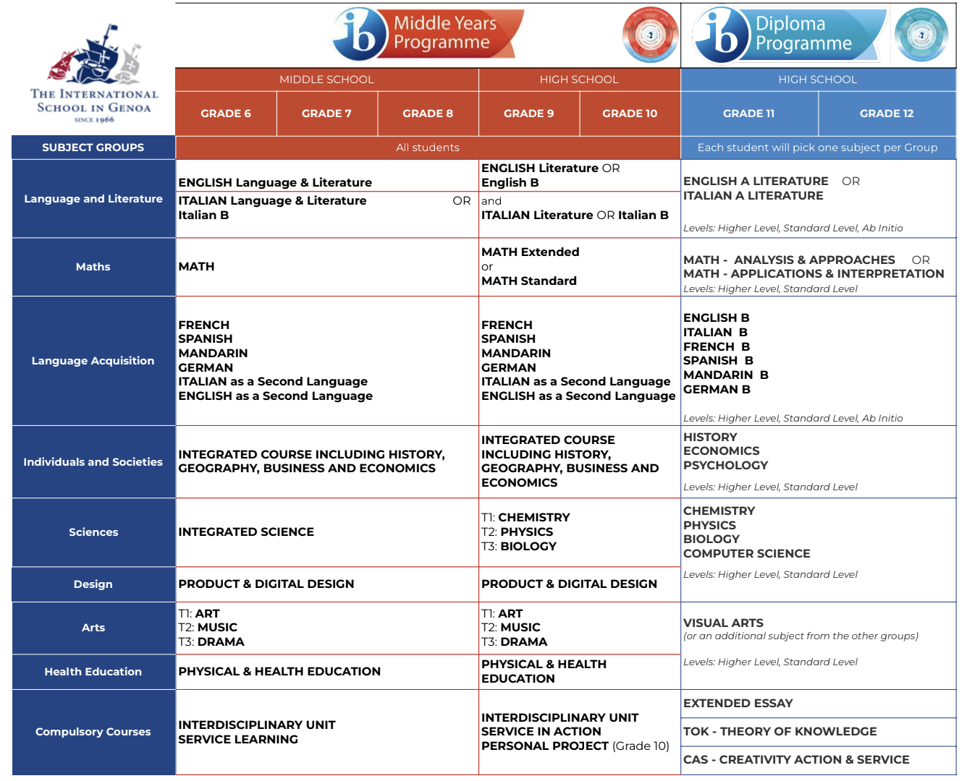
MYP subjects offered at ISG
The MYP feeds into the DP
Students are streamed into English A or English B, Italian A or B, and Math Extended or Standard in Grade 9
New for Academic year 2024-2025: 4 hours of math in grade 9 (and grade 10); in grade 9 the introduction of a third math group
Students in Grade 9 study on a trimester rotation:
Sciences: Biology/Chemistry/Physics
Students in Grade 10 choose two of:
Arts: Visual Arts/Music/Drama
Sciences: Biology/Chemistry/Physics
OR they have the option to take one of these course for the entire year.
Notes:
It’s important that we are actively preparing our students throughout the MYP to be ready for the rigors of the DP, so in Grade 9, teachers, students, and parents start making decisions about course selection. Starting in Grade 9, ISG streamlines students into English A or English B, Italian A or Italian B, and Extended or Standard Math. Also, starting this year, Grade 9 and 10 students have four hours of Math instruction, and also in Grade 9, students study Biology, Chemistry, and Physics on a trimester rotation so they can experience all subjects before moving into Grade 10. In grade 10, students have the option to choose two of the three science course, one each semester OR they can take one for the entire year, allowing them to pursue that class at the HL level in the DP. Also in grade 10, students can choose two of the arts classes: Visual Arts, Music, or Drama. Finally, in order to support our 10th graders with their academic writing, we’ve also added an extra hour of English writing instruction that takes place during one of the two advisory periods each week.

Slide 13
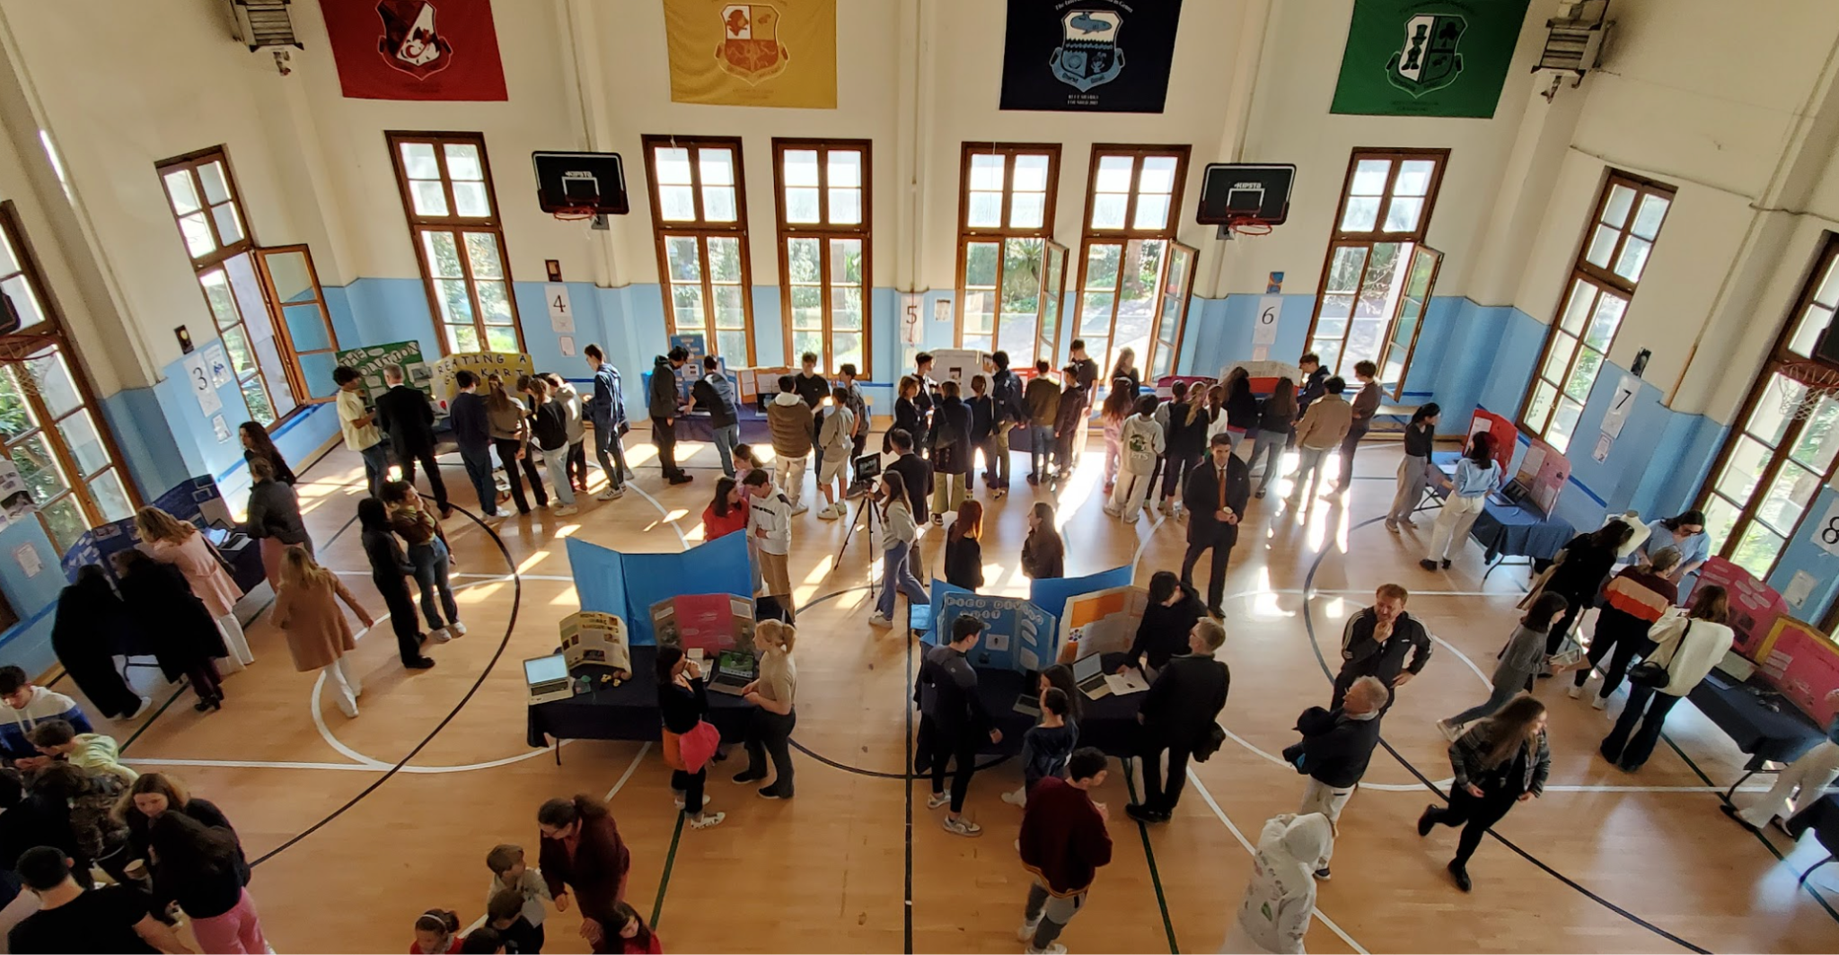
Other requirements: Personal Project & Service as Action
All students in Grade 10 will take part in the MYP Personal Project. This is a student-directed extended project which holds high importance in the MYP and reflects the students’ experience of the programme. The project provides an excellent opportunity for students to produce a truly personal and creative piece of work of their choice to demonstrate the skills they have developed in the approaches to learning.
Each student will have their own supervisor to oversee the process and all learning is celebrated with an end of year Personal Project exhibition.
Grade 10 Personal Project Exhibition, March 2023
Notes:
This not only is a wonderful way to celebrate the culmination of their learning throughout the MYP, and a way to share this with the community via a final exhibition, it allows students to truly be authors of their own learning, and also sets them up to be a self-actualising learner in the DP - think about the courseworks/IAs they have to do, and how they have to plan their own time and juggle many commitments.

Slide 14
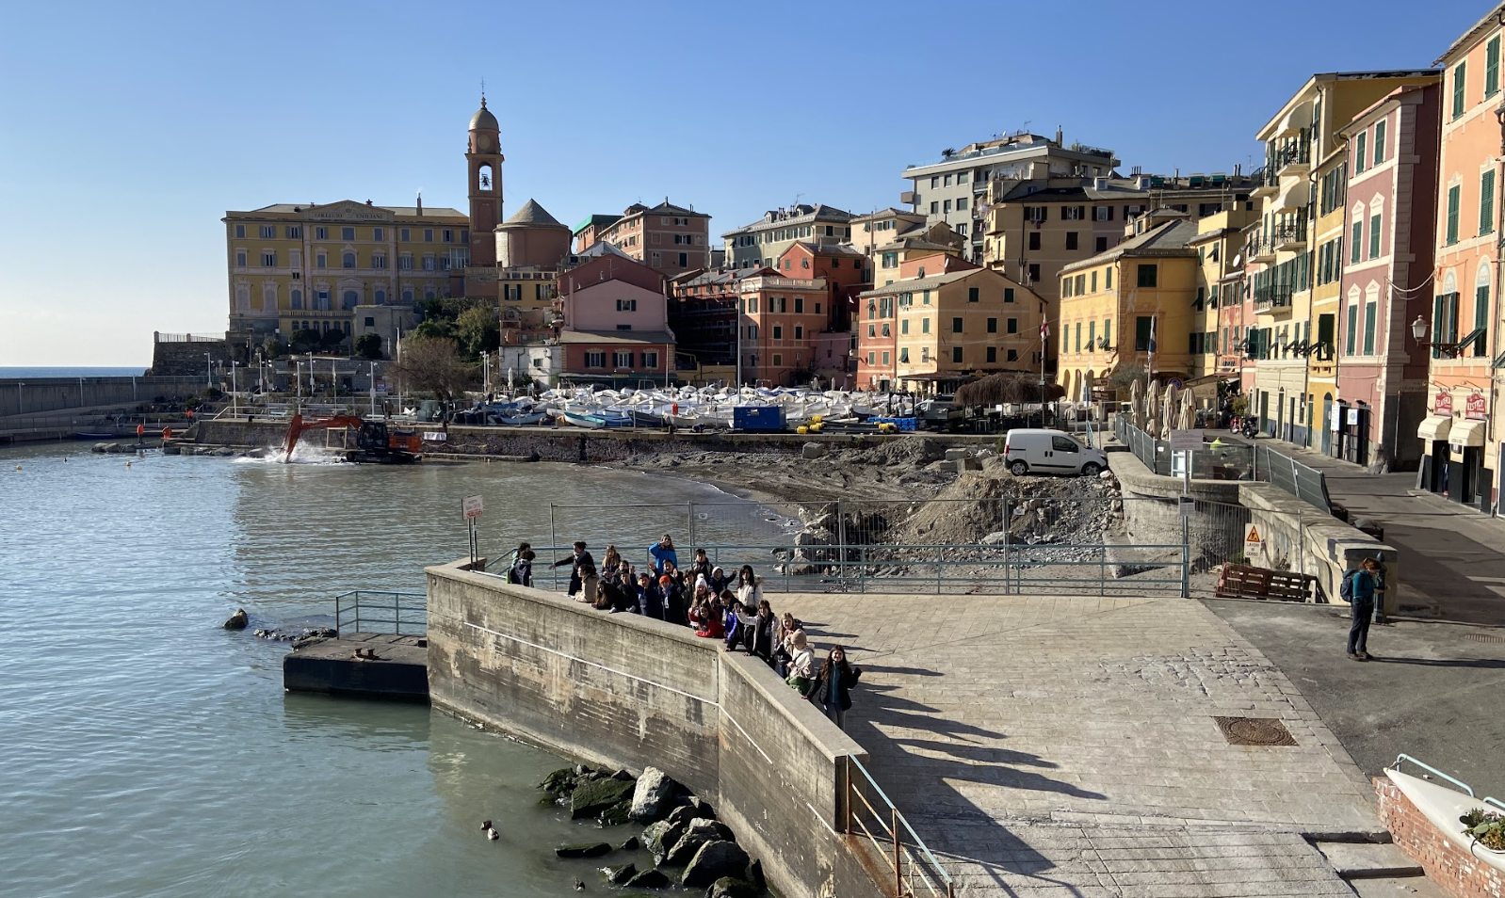
Other requirements: Personal Project & Service as Action
Service learning in the MYP is a dynamic educational approach that empowers students to combine classroom learning with meaningful community service.
Service is a fundamental component of the MYP curriculum, fostering holistic development by integrating academics with real-world experiences.
Our service learning program is strategically designed to offer diverse age-appropriate opportunities for students in every grade, culminating in a significant project in MYP 5 (Grade 10). There may be opportunities for service within units of learning, or outside the classroom.
This is a growing programme and we have recently appointed a Service Leader (Dario Polmonari) who also is heading the grade-level trips.
Nervi Porticciolo Beach Clean Up, June 2023

Slide 15
Further resources
Middle School - International School of Genoa
High School - International School of Genoa
Middle Years Programme (MYP) - International Baccalaureate®
Notes:
–

Slide 16
Thank you for your attention!
Any questions?

